Slide 1
Keystone Bootloader

Slide 2
Agenda
The BOOT
Motivation
RBL
Boot Modes
configuration pins
magic address
triggering and reset
File formats
DSP formats
ARM formats
TI Tools

Slide 3
Agenda
modes details
DSP
ARM
Two step boot
IBL
Boot multiple cores
U-boot

Slide 4
Agenda
The BOOT
Motivation
RBL

Slide 5
Some Lines from the Gel routine at connect
Global_Default_Setup_Silent()
{
Set_DSP_Cache();
if (DNUM == 0)
{
status = Init_PLL(PLL1_M, PLL1_D);
// Setup all Power Domains on
Set_Psc_All_On( );
}
// Setup Pll3 pass clk @ 1050 MHz
Init_Pll3(PLLM_PASS, PLLD_PASS);
// Setup Pll2 DDR3 PLL @ 667 MHz
Init_Pll2(PLLM_DDR, PLLD_DDR);
xmc_setup();
ddr3_setup_auto_lvl_1333(0);
}
// Configure SGMII SERDES
configSGMIISerdes();
EnableEDC_OneforAll();
GEL_TextOut( "Configuring CPSW ...\n");
setCpSwConfig();
}

Slide 6
Some Lines from the Gel routine during load
OnFileLoaded(int nErrorCode, int bSymbolsOnly)
{
// Allows only core 0 can do i2c programming
if (DNUM == 0)
{
// Checks if eeprom i2c programming was started
if (i2cprog!=0)
{
// Test for little endian
if (i2cprog==LITTLE_END)
{
// For little endian
// Remove i2c eeprom switch
i2cprog=0;
// Load data file to program
GEL_MemoryLoad(0x900000, 0, 0x10000, "$(GEL_file_dir)\\dsprom.dat");
// Load i2c programmer parameters file
GEL_MemoryLoad(0x800000, 0, 0x60, "$(GEL_file_dir)\\..\\i2crom\\params_le.dat");
// Programs the dsp eeprom
GEL_Run();
}

Slide 7
Generic Boot Procedure

Slide 8
Rom Boot Loader (RBL): Definition
Rom Boot Loader (RBL):
Software code used for device startup.
Burned in ROM (non-modifiable) during manufacture
Has a base address of 0x20B00000 (DSP), 0x00000000 (ARM)
RBL can be executed by C66x core or the ARM core. The boot behavior varies depending on the core type that initiates the boot process.
C66x CorePac
ROM
ARM CorePac

Slide 9
Boot Process Requirements
Selecting the method of booting
what CPU (ARM 0 or DSP core 0) manages the boot
All other cores are in idle, waiting for interrupt
What boot mode to use
Updating the configuration
Trigger to use the configuration to prepare for booting
Configuring the device (PLLs and more)
Load the image of the executable into the device
Trigger all cores to run the executable

Slide 10
ARM - DSP Boot Loader (RBL)
RBL responsible for device start up and transfers application code from memory or host to high speed internal memory or DDR3
RBL code is burned in the DSP ROM Base address 0x20B00000 and ARM base address 0x00000000
Various boot modes are supported
These boot modes are broadly divided into tree groups
Memory boot where the application code is stored in a slow external memory and DSP acts as a master and drives the boot process.
Host boot with the host can write directly to memory and has the knowledge of the memory map of the boot device
Host boot with host unaware of the memory structure of the boot device and a CPU moves the data into the memory

Slide 11
More about BOOT Modes
Master Mode – CPU manages the boot process
Either DSP core 0 or ARM A15 core 0
CPU configures peripheral and reads the boot information
Example – I2C master mode, SPI boot, EMIF 16 boot
Slave Mode Direct IO – CPU needs to configure a peripheral
External master configures the other registers and loads the code
Example – Hyperlink boot, PCIe boot, SRIO direct IO
Slave Mode message based – CPU configures a peripheral and manages the protocol
Ethernet where CPU manages the packets
SRIO messages where CPU configures the SRIO master and then the SRIO manages the download

Slide 12
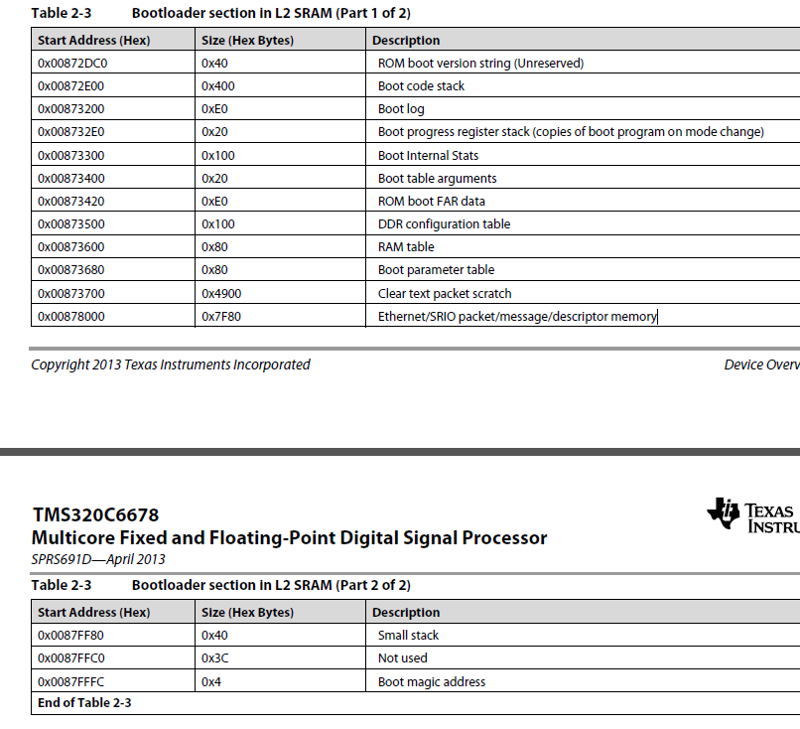
Boot Process Memory Usage and Magic address (1)
DSP boot uses part of L2 for the boot process
Address depends on the device, for 6678 starts at 0x0087 2DC0

Slide 13
Boot Process Memory Usage and Magic address (2)
Do not put code or initialized memory in these locations
(Notice that this address is usually where L2 cache is)
Magic Address – the address to where a core goes after the boot process (idle, after it gets an interrupt)
The last 4 bytes of L2, for 6678 it is 0x0087 fffc (local)
The boot process must enter the start address to Magic address location before generating interrupt for all the cores
Obviously, the boot process uses the global magic address location (of all other cores)
What about ARM boot?
Similar tables are used by the ARM and are located in MSMC memory
Different magic address for different boot, will see later

Slide 14
KeyStone PLL Settings
The user can set the different PLL settings for the proper operation of the device
Each device data manual has one or more PLL tables
The System PLL settings is used for setting the system clock configuration.
ARM PLL settings is used for the ARM clock speed configuration.
PA PLL settings is used for the PA clock configuration.

Slide 15
Example of PLL Configuration
The boot code sets the PLL multiplier based on the core frequency set in the EFUSE register
PLL Clock Configuration for KeyStone Devices
Boot PLL Select [2:0] | Input Clock Freq (MHz) | core = 800 MHz |  | core = 1000 MHz |  | core = 1200 MHz |  | core = 1400 MHz
 |  | Clkr | Clkf | Clkr | Clkf | Clkr | Clkf | Clkr | Clkf
0 | 50.00 | 0 | 31 | 0 | 39 | 0 | 47 | 0 | 55
1 | 66.67 | 0 | 23 | 0 | 29 | 0 | 35 | 0 | 41
2 | 80.00 | 0 | 19 | 0 | 24 | 0 | 29 | 0 | 34
3 | 100.00 | 0 | 15 | 0 | 19 | 0 | 23 | 0 | 27
4 | 156.25 | 24 | 255 | 4 | 63 | 24 | 383 | 24 | 447
5 | 250.00 | 4 | 31 | 0 | 7 | 4 | 47 | 4 | 55
6 | 312.50 | 24 | 127 | 4 | 31 | 24 | 191 | 24 | 223
7 | 122.88 | 47 | 624 | 28 | 471 | 31 | 624 | 13 | 318
PLL Clock O/P = (Input Clock x (Clkf + 1))/(2 * (Clkr + 1))

Slide 16
RBL Flow
Diagram
Boot Start
No
POR or RESETFULL?
Yes
Check the PWRSTATECTL Register for hibernation
Latch the boot mode from the Boot Strap Pins
(DEVSTAT)
No
Boot Parameter Table init
Hibernation?
Yes
Yes
Initialize the PLLs
PLL required?
Branch to the address provided by the PWRSTATECTL
No
PLL is bypassed
Branch to function depending on the boot mode
Boot mode specific process

Slide 17
Agenda
Boot Modes
configuration pins
magic address
triggering and reset

Slide 18
keyStone I Boot Configuration Pins
Boot mode and configurations are chosen using bootstrap pins on the device.
Pins are latched and stored in13 bits of the DEVSTAT register during POR.
The configuration format for these 13 bits are shown in the table:
Boot Device [2:0] is dedicated for selecting the boot mode
Device Configuration [9:3] is used to specify the boot mode specific configurations.
PLL Multi [12:10] are used for PLL selection. In case of I2C/SPI boot mode, it is used for extended device configuration. (PLL is bypassed for these two boot modes)
Boot Mode Pins
12 | 11 | 10 | 9 | 8 | 7 | 6 | 5 | 4 | 3 | 2 | 1 | 0
PLL Mult I2C/SPI Ext Dev Cfg |  |  | Device Configuration |  |  |  |  |  |  | Boot Device

Slide 19
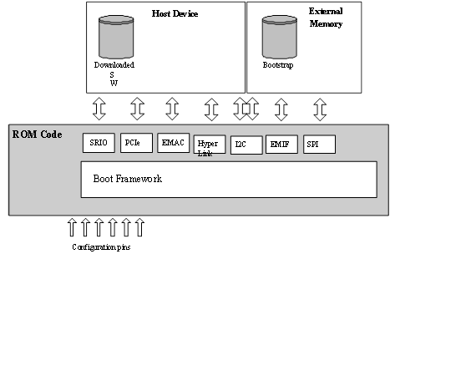
KeyStone I ROM Boot Modes
Ethernet Boot (boot from external host connected through Ethernet)
PCIe Boot (boot from external host connected through PCIe )
HyperLink Boot (boot from external host connected through HyperLink)
EMIF16 NOR Boot(boot from NOR Flash)
Device Manual will detail supported types.
Some members have NAND boot as well
I2C Boot
Master Boot (from I2C EEPROM)
Master-Broadcast Boot(Master Boot followed by broadcast to slave cores)
Passive Boot (external I2C host)
SPI Boot (from SPI flash)
SRIO Boot(from external host connected through SRIO)

Slide 20
KeyStone I Boot Device
Boot Device Selection Values
For interfaces supporting more than one mode of operation, the configuration bits are used to establish the necessary settings
Boot Mode Pins: Boot Device Values
Value | Boot Device
0 | Sleep(6670) / EMIF16¹
1 | Serial Rapid I/O
2 | Ethernet (SGMII) (PA driven from core clk)
3 | Ethernet (SGMII) (PA driver from PA clk)
4 | PCIe
5 | I2C
6 | SPI
7 | HyperLink
1. See the device-specific data manual for information.

Slide 21
KeyStone II Boot Modes and ARM master boot
The different boot methods are:
Sleep boot
I2C master boot
SPI boot
NAND boot
XIP boot
UART boot
Ethernet boot
SRIO boot
HyperLink boot
PCIe boot
The various boot mode available depend on the device used.
To select the boot mode refer to the data manual for the different options available

Slide 22
KeyStone II boot strap selection
DEVSTAT Boot Mode Pins ROM Mapping
16 | 15 | 14 | 13 | 12 | 11 | 10 | 9 | 8 | 7 | 6 | 5 | 4 | 3 | 2 | 1 | Mode
X | X | 0 | Arm en | Sys en | ARM PLL Cfg |  |  | Boot Master | Sys PLL Cfg |  |  | min | 0 | 0 | 0 | Sleep
Slave Addr |  | 1 | Port |  | ARM PLL Cfg |  |  |  |  |  |  |  | 0 | 0 | 0 | I2C Slave
X | X | X | Bus Address |  | Param Idx / Offset |  |  |  | X | Port |  |  | 0 | 0 | 1 | I2C Master
width | csel |  | mode |  |  |  |  |  | Npin |  |  |  | 0 | 1 | 0 | SPI
0 | base |  | wait | width | ARM PLL Cfg |  |  |  | Sys PLL Cfg |  |  | 0 | 0 | 1 | 1 | XIP (ARM Master)
 |  |  |  |  | X | Chip sel |  |  |  |  |  |  |  |  |  | XIP (GEM Master)
1 | First Block |  |  | Clear | ARM PLL Cfg |  |  |  |  |  |  | min |  |  |  | NAND (ARM Master)
 |  |  |  |  | X | Chip Sel |  |  |  |  |  |  |  |  |  | NAND (GEM Master)
lane | Ref Clock |  | Data Rate |  | ARM PLL Cfg |  |  |  |  |  |  |  | 1 | 0 | 0 | SRIO (ARM Master)
X |  |  |  |  | Lane Setup |  |  |  |  |  |  |  |  |  |  | SRIO (GEM Master)
Pa clk | Ref Clk |  | Ext Con |  | ARM PLL |  |  |  |  |  |  |  | 1 | 0 | 1 | Ethernet (ARM Master)
 |  |  |  |  | rsvd | Lane Setup |  |  |  |  |  |  |  |  |  | Ethernet (GEM Master)
Ref clk | Bar Config |  |  |  | ARM PLL |  |  |  |  |  |  | 0 | 1 | 1 | 0 | PCIe (ARM Master)
 |  |  |  |  | SerDes Cfg |  |  |  |  |  |  |  |  |  |  | PCIe (GEM Master)
Port | Ref Clk |  | Data Rate |  | ARM PLL |  |  |  |  |  |  | 1 | 1 | 1 | 0 | Hyperlink (ARM Master)
 |  |  |  |  | SerDes Cfg |  |  |  |  |  |  |  |  |  |  | Hyperlink (GEM Master)
X | X | X | X | Port | ARM PLL |  |  |  | Sys PLL Cfg |  |  | min | 1 | 1 | 1 | UART (ARM Master)
X | X | X | X |  | X | X | X |  |  |  |  |  |  |  |  | UART (GEM Master)

Slide 23
Triggering the BOOT process
Triggers are mechanisms that initiates the execution of the RBL. KeyStone devices use resets as triggers.
Four types of resets:
Power on Reset (PoR)
Reset Full
Reset
Local Reset

Slide 24
Reset Types
Power on Reset (POR) (Cold Reboot)
Resets everything
Latches the boot strap pins
RBL Process initiated
RESETFULL (Warm Reboot)
Resets everything
Latches the boot strap pins
RBL Process initiated
RESET (Can be configured as hard or soft)
Resets everything except EMU and reset isolated peripherals.
No latching of the boot strap pins.
For software reset PCIe, EMIF16, DDR3 and EMIF MMRs are also preserved.
RBL process is initiated.
LRESET
Mostly used by watch dog timer
Just the CorePac is reset all the memory are preserved.
No RBL process is initiated.

Slide 25
Agenda
File formats
DSP formats
ARM formats
TI Tools

Slide 26
KeyStone I Boot Formats
Boot Parameter Table is a configuration table, part of the boot process table. It contains two parts:
Common set of parameters for system configuration
Unique parameter settings for each boot method
Masters boot modes expect two tables
Boot Table contains code that needs to be loaded into the device.
Boot Configuration Table is a register configuration table that is used to manipulate memory map registers.

Slide 27
Boot Parameter Format
Boot Parameter Table:
Provides a “map” for the boot process
The boot process copies a default Boot Parameter Table into a reserved L2 of Core 0.
The first 10-byte of the Boot Parameter Table are common across all the boot modes:
Length
Checksum
Boot Mode
Port Num
PLL configuration (most significant bits)
PLL configuration (least significant bits)
The rest of the Boot Parameter Table is boot-mode dependent.

Slide 28
Boot Parameter Table Setup
0x00000000
or
0x20B00000
RBL Code…
The RBL contains a default boot parameter table for each boot mode (shown in the middle of the RBL Code section to the right)
After POR or RESETFULL the RBL checks the DEVSTAT register for the boot mode selected (SPI for example)
The RBL then copies the default SPI boot parameter table to the boot parameter table section of either L2 (DSP master boot) or MSMC (ARM master boot)
Finally the RBL updates the copied table with any custom configurations that were passed in when the boot strap pins were latched into the DEVSTAT register
Once the custom parameter table is stored in L2 or MSMC the RBL uses it as a blueprint for the rest of the boot
(Colors are meant to show that these are completely separate sections in the device memory map)
Default I2C Parameter Table
Default SRIO Parameter Table
Step 3
Default … Parameter Table
Default SPI Parameter Table
RBL Code…
Step 4
DEVSTAT Register
0x02620020
L2 or MSMC
Memory space used by RBL …
Custom SPI Parameter Table
Memory space used by RBL …
End of L2 or MSMC

Slide 29
Boot Image Format
Boot Table:
Block of data that contains code and data sections
The block is loaded from the host or external memory to the internal memory or DDR by the RBL.
The first 8 bytes of each section in the Boot Table form the section’s header:
32-bit section bytes count
32 bit section address where the block has to be moved
The end of table is identified by writing 0s.

Slide 30
Register Configuration Format
Boot Configuration Table:
Provides read/modify/write capabilities to any MMR on the device.
Each entry has three 32-bit-wide elements.
First element is the address to be modified
Second element is the set mask
Third element is the clear mask
If all three elements are 0s, this indicates the end of the Boot Configuration Table.

Slide 31
What about Slave Direct IO Modes
The master should take care of loading the code and do the MMR configurations
TI provides set of tools to help, for example, for DSP code
Hex6x
Converts DSP out format into hex ASCII format
Hex6x is described in TI assembly tools User Guide http://www.cs.cmu.edu/afs/cs/academic/class/15745-s05/www/c6xref/assembly.pdf

Slide 32
KeyStone I Additional Utilities
Building the boot table:
If the EVM is set in little endian mode, convert the boot table to big endian mode (used by the RBL) using the bconvert64x utility (available in MCSDK).
Convert to an I2C format (to be loaded into the EEPROM) using the b2i2c utility (available in MCSDK).
Append the boot parameter table to the boot table using romparse (Available in MCSDK), which uses a map file to retrieve the boot parameter tables.

Slide 33
KeyStone II ARM Boot Blob Image formats
Binary Large Object
Treats the executable as a data byte stream
The BLOB will cover the entire memory location used by the application
When the BLOB is received, the RBL will load it in the base of MSMC.
Future devices may use other addresses
“self relocating code” must be used if the code must be places in other memories (DDR)
Blob format is used for PCIe boot, UART boot, Ethernet boot
Once the blob loading is complete, the RBL jumps the core0 PC to base of MSMC and starts executing
Magic address of the ARM:
Core 0 – 0x0C5A D000, Core 1- 0x0C5A D004, core 2 – 0x0C5A 0008, core 3 – 0x0C5A D00C

Slide 34
KeyStone II Blob Generation Tools
armhex
convert the .out file into an ASCII hex file
Location in ccs_v5_4_x\ccsv5\tools\compiler\arm_X.X.X\bin
Usage of armhex is described in SPNU118L – Arm Assembly language tools
b2ccs.exe
converts the ASCII hex file into a CCS .dat format
A format that CCS uses to load data via the CCS memory browser
Acting as intermediate format for boot
ccs2bin.exe –
converts the CCS .dat format to a blob

Slide 35
KeyStone II ARM General Purpose Header (GPH) formats
Similar to boot table for DSP boot but without start address, used by EMIF NOR and NAND boot, SPI boot, I2C boot
GPH format is
Block 0 length
Block 0 Base Address
Block 0 data
…
Block last length
Block last base address
Block last data
Termination (0 for block length)
During boot, once the end of table is reached, RBL jumps to the base address of the last block

Slide 36
KeyStone II - Tools to build the GP format
armhex – out file to ASCII Hex file
B2css – hex file to CCS format
ccsAddGphdr – adds a general purpose header to your CCS .dat file and also updates the CCS .dat header to account for the added 8 bytes of length
ccsAddGptlr – adds a general purpose tail to your CCS .dat file and also updates the CCS .dat header to account for the added 8 bytes of length
Catccs - use to combined two CCS format files into a single file, for two stage boot for example

Slide 37
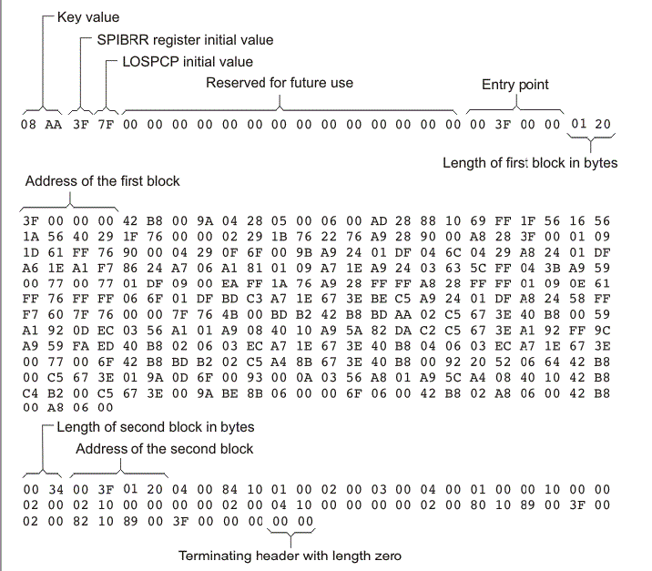
Hex Converter out for 8-bit SPI boot Taken from SPNU118L Chapter 12

Slide 38
Agenda
modes details
DSP
ARM

Slide 39
KeyStone I I2C Master Boot
PLL is in bypass mode.
Can be used to run a work-around before running the main boot method
Can modify the boot parameter table that is used by RBL.
After running the work-around, can modify the boot parameter table to boot in another boot method.
Images are stored in the EEPROM in two pages that are divided into blocks of 0x80 bytes.

Slide 40
KeyStone I Boot Modes Summary
I2C slave
device configuration uses 5 bits of device configuration and the I2C address is calculated by adding 0x19 to the I2C address specified in the device configuration
SPI Boot
Same as I2C mode, instead of pages, the NOR flash is selected based on the chip select
Ethernet Boot
Configure the SERDES and NetCp if available, but not the PHY
SRIO BOOT
Support direct IO (slave mode) and type 11 messages (similar to Ethernet)

Slide 41
KeyStone I Boot Modes Summary (cont)
PCI Boot
Only End Point (DSP), similar to SRIO direct IO, supports legacy interrupt as well as EP interrupt
Hyperlink Boot
Similar to SRIO direct IO, Hyperlink interrupt is connected to core 0

Slide 42
KeyStone II Boot Loading Process - I2C Boot
PLL are bypassed in this mode.
The application to be loaded is converted into a GP header format table and loaded in the EEPROM.
Generally a two stage bootloader process is carried out.
First stage will load the image that has the PLL settings and modifies the boot parameter table to point to the next address in EEPROM where the real image is loaded. Then re-enter the RBL
In second stage the real image is loaded.

Slide 43
KeyStone II Boot Loading Process -XIP boot
The image to be loaded is in the GP header format and loaded in the EMIF NOR flash.
Once the boot is triggered, the GP header blocks are loaded based on the base address and the byte size.
Once the last block is detected, the RBL branches ARM core0 to the base address specified in that block and starts executing.
See device Errata

Slide 44
KeyStone II Boot Summary
SPI Boot
PLL are bypassed in this mode. GP format
Ethernet Boot
Does not initialize the Phy, need ip address, blob format to MCMS memory
SRIO Boot
Direct IO and messages, GP format in messages, blob in direct IO
PCI boot
Blob format, BAR and SERDES are configures, EP mode
Hyperlink boot
Blob format, configure interrupt to the ARM

Slide 45
KeyStone II Boot Summary (Cont)
NAND BOOT
GP format, similar to I2C or SPI
UART Boot
Blob format, using XMODEM protocol

Slide 46
Agenda
Two step boot
IBL
Boot multiple cores
U-boot

Slide 47
Second Stage Boot Load Process
Q: What if more boot parameters are needed than can be specified in the boot pins?
A: Other parameter values can be updated through the I2C boot mode.
In this case, the I2C boot starts with an I2C boot parameter table which in turn loads a custom updated parameter table for a specific boot mode.
Once the default parameter table is updated, the boot code executes using the updated boot parameter structure, following the same process as the primary boot mode.

Slide 48
Second Stage Boot Load Specifics
The loaded EEPROM image has two boot parameter table blocks.
The first block is an I2C boot parameter table, which sets the core clock and the address of the next block.
The next block includes the requested boot mode-specific boot parameter table with user-specified values.
After loading this image, the boot mode in the boot strap is set for I2C master boot.
After POR, the I2C boot code is executed as a first-stage boot load, which updates the default boot parameter table and re-enters the boot code, executing the boot code utilizing the user-specific parameters.

Slide 49
Intermediate Boot Loader (IBL)
Originally created as a work-around for a PLL locking issue in the C667x PG1.0 version.
Same process as second stage boot loading.
Also provides additional boot features:
TFTP boot
NAND boot
NOR boot
In the EVM, the FPGA is programmed to boot IBL, execute the PLL fix, and then jump right back to RBL for the set boot mode.

Slide 50
KeyStone I Booting Multiple Cores
During the boot process, the boot loader code is loaded into the L2 of CorePac 0 from the ROM.
The high 0xD23F (52K) bytes of L2 in all CorePacs are reserved for the boot code. User should not overwrite this area.
All the other cores will execute an IDLE.
User should load the image into the L2 of CorePacs they want to boot.
Before setting the Boot Complete register, the user should also set the start address of the code in the respective BOOT MAGIC ADDRESS of the CorePac L2.
Finally, the user image should also write the IPC Interrupt register to bring the required CorePacs out of IDLE.

Slide 51
KeyStone II Booting Multiple cores
ARM core0 is the master core.
During the boot process the other ARM cores if available are shut down.
The application that is running in ARM core0 needs to update the ARM magic address and then power up the other ARM cores in the tetras.
Once powered up the other ARM cores will start executing from the address specified in the ARM magic address
To boot the DSP cores, MPM utility is used
The multi-proc manager (MPM) provides services to load, run, and manage slave processors
MPM must be used to load the DSP code if IPCv3 is used

Slide 52
U-BOOT (1/2)
U-BOOT is an open source cross-platform boot loader application that facilitate loading images and more
In addition to configure the hardware, the U-BOOT enables the user to
read and write arbitrary memory location
loading image into RAM
Copying data into the flash
Provide starting address for the code

Slide 53
U_BOOT (2/2)
U-BOOT monitor application enables controlling U-BOOT from external terminal
The user can define a set of parameters (Environment variables) that controls the BOOT process. These parameters are stored in flash.
U-BOOT has a set of commands
Setenv – define an environment variable
Printenv – shows the current parameters (environment variables)
Saveenv – save new setting into the flash
The next slide shows part of the printenv results for my EVM

Slide 54
TCI6638 EVM # printenv
addr_uboot=0x87000000
args_all=setenv bootargs console=ttyS0,115200n8 rootwait=1
args_net=setenv bootargs ${bootargs} rootfstype=nfs root=/dev/nfs rw nfsroot=${serverip}:${nfs_root},${nfs_options} ip=192.168.0.53:::::eth0:off
args_ramfs=setenv bootargs ${bootargs} earlyprintk rdinit=/sbin/init rw root=/dev/ram0 initrd=0x802000000,80M
boot=net
bootcmd=run init_${boot} get_fdt_${boot} get_mon_${boot} get_kern_${boot} run_mon run_kern
gatewayip=192.168.0.1
get_fdt_ramfs=tftp ${addr_fdt} ${tftp_root}/${name_fdt}
get_mon_net=tftp ${addr_mon} ${tftp_root}/${name_mon}
init_net=run args_all args_net
init_ramfs=run args_all args_ramfs get_fs_ramfs
ipaddr=192.168.0.53
mem_lpae=1
mem_reserve=512M
name_fdt=uImage-k2hk-evm.dtb
name_fs=tisdk-rootfs.cpio.gz
nfs_options=v3,tcp,rsize=4096,wsize=4096
nfs_root=/opt/filesys/student3
run_kern=bootm ${addr_kern} - ${addr_fdt}
run_mon=mon_install ${addr_mon}
serverip=192.168.0.100
tftp_root=student3

Slide 55
Questions? Thanks !

Slide 56
Back Up

Slide 57
Hibernation
Hibernation 1
The application needs to ensure that the chip control register is set correctly to avoid MSMC reset.
Hibernation 2
MSMC is reinitialized to default values.
For both modes, the Application is responsible for shutdown of all desired IP blocks.
A hard or soft reset can be configured to bring a hibernating device out of hibernation
After the reset, the boot loader code checks the PWRSTATECTL register to identify the hibernation mode and branch address and recovery master.
Subsequent Actions
Peripherals and CorePacs are powered
The awakened device branches to the application code which utilizes the values stored in MSMC or DDR3 prior to hibernation and the recovery master starts the recovery process.

Slide 58
Boot Configuration I2C Passive Mode
In passive mode the I2C Device Configuration uses 5 bits of device configuration instead of 7 used in master mode.
In passive mode the device does not drive the clock, but simply acks data received on the specified address.
The I2C address is calculated by adding 0x19 to the I2C address specified in the device configuration.
Header format: (0x19 + I2C address) xx xx yy yy zz zz
xx xx = length, yy yy = checksum, zz zz = boot option
I2C Passive Mode Device Configuration Bit Fields
9 | 8 | 7 | 6 | 5 | 4 | 3
Rsvd (Must be 1) | Mode (1) | Receive I2C Address
I2C Passive Mode Device Configuration Field Descriptions
Bit Field | Value | Description
Mode | 0 | Master Mode
 | 1 | Passive Mode
Address | 0-7 | The I2C Bus address the device will listen to for data

Slide 59
Boot Configuration – SPI Mode
Similar to I2C, the bootloader reads either a boot parameter table or boot config table that is at the address specified by the first boot parameter table and executes it directly.
SPI Device Configuration Bit Fields
12 | 11 | 10 | 9 | 8 | 7 | 6 | 5 | 4 | 3
Mode (clk Pol/Phase) |  | 4,5pin | Addr Width | Chip select |  | Parameter Table
SPI Device Configuration Field Descriptions
Bit Field | Value | Description
Mode | 0 | Data is output on the rising edge of SPICLK. Input data is latched on the falling edge.
 | 1 | Data is output one half-cycle before the first rising edge of SPICLK and on subsequent falling edges. Input data is latched on the rising edge of SPICLK.
 | 2 | Data is output on the falling edge of SPICLK. Input data is latched on the rising edge.
 | 3 | Data is output one half-cycle before the first falling edge of SPICLK and on subsequent rising edges. Input data is latched on the falling edge of SPICLK.
4,5 pin | 0 | 4 pin mode used
 | 1 | 5 pin mode used
Addr Width | 0 | 16 bit address values are used
 | 1 | 24 bit address values are used
Chip Select | 0-3 | The chip select field value
Parameter Table Index | 0-3 | Specifies which parameter table is loaded
SR Index | 0-3 | Smart Reflex Index

Slide 60
Boot Configuration – EMIF16 Mode
EMIF16 mode is used to boot from the NOR flash.
The boot loader configures the EMIF16 and then sets the boot complete bit corresponding to corePac0 in the boot complete register and then branches to EMIF16 CS2 data memory at 0x70000000.
No Memory is reserved by the boot loader.
Sleep / EMIF16 Configuration Bit Fields
9 | 8 | 7 | 6 | 5 | 4 | 3
Reserved |  | Wait Enable | Sub-Mode |  | SR Index
Sleep / EMIF16 Configuration Bit Field Description
Bit Field | Value | Description
Sub-Mode | 0b00 | Sleep Boot
 | 0b01 | EMIF16 boot
 | 0b10-0b11 | Reserved
Wait Enable | 0b0 | Wait enable disabled (EMIF16 sub mode)
 | 0b1 | Wait enable enabled (EMIF16 sub mode)

Slide 61
Boot Configuration – Ethernet
Ethernet(SGMII) boot configuration sets SERDES clock and device ID.
Ethernet (SGMII) Device Configuration Bit fields
9 | 8 | 7 | 6 | 5 | 4 | 3
SERDES Clock Mult |  | Ext connection |  | Dev ID
Bit field | Value | Description
Ext connection | 0 | Mac to Mac connection, master with auto negotiation
 | 1 | Mac to Mac connection, slave, and Mac to Phy
 | 2 | Mac to Mac, forced link
 | 3 | Mac to fiber connection
Device ID | 0-7 | This value is used in the device ID field of the Ethernet ready frame. Bits 1:0 are use for the SR ID.
SERDES Clock Mult The output frequency of the PLL must be 1.25 GBs. | 0 | x8 for input clock of 156.25 MHz
 | 1 | x5 for input clock of 250 MHz
 | 2 | x4 for input clock of 312.5 MHz
 | 3 | Reserved

Slide 62
Boot Configuration – Serial RapidIO
SRIO boot configuration sets the Clock, Lane configuration, and mode
Rapid I/O Device Configuration Bit Fields
9 | 8 | 7 | 6 | 5 | 4 | 3
Lane Setup | Data Rate |  | Ref Clock |  | SR ID
SRIO Configuration Bit Field Descriptions
Bit Field | Value | Description
SR ID | 0-3 | Smart Reflex ID
Ref Clock | 0 | Reference Clock = 156.25 MHz
 | 1 | Reference Clock = 250 MHz
 | 2 | Reference Clock = 312.5 MHz
Data Rate | 0 | Data Rate = 1.25 GBs
 | 1 | Data Rate = 2.5 GBs
 | 2 | Data Rate = 3.125 GBs
 | 3 | Data Rate = 5.0 GBs
Lane Setup | 0 | Port Configured as 4 ports each 1 lane wide (4 -1x ports)
 | 1 | Port Configured as 2 ports 2 lanes wide (2 – 2x ports)

Slide 63
Boot Configuration – PCI Express
In PCIe mode, the host configures memory and loads all the sections directly to the memory.
PCI Device Configuration Bit Fields
9 | 8 | 7 | 6 | 5 | 4 | 3
Rsvd | BAR Config |  |  |  | SR ID
PCI Device Configuration Bit Fields
Bit Field | Value | Description
SR ID | 0-3 | Smart Reflex ID
Bar Config | 0-0xf | See Next Slide

Slide 64
Boot Configuration – PCI Express
BAR Config / PCIe Window Sizes
 |  | 32 bit Address Translation |  |  |  |  | 64 bit Address Translation
BAR cfg | BAR0 | BAR1 | BAR2 | BAR3 | BAR4 | BAR5 | BAR1/2 | BAR3/4
0b0000 | PCIe MMRs | 32 | 32 | 32 | 32 | Clone of BAR4
0b0001 |  | 16 | 16 | 32 | 64
0b0010 |  | 16 | 32 | 32 | 64
0b0011 |  | 32 | 32 | 32 | 64
0b0100 |  | 16 | 16 | 64 | 64
0b0101 |  | 16 | 32 | 64 | 64
0b0110 |  | 32 | 32 | 64 | 64
0b0111 |  | 32 | 32 | 64 | 128
0b1000 |  | 64 | 64 | 128 | 256
0b1001 |  | 4 | 128 | 128 | 128
0b1010 |  | 4 | 128 | 128 | 256
0b1011 |  | 4 | 128 | 256 | 256
0b1100 |  |  |  |  |  |  | 256 | 256
0b1101 |  |  |  |  |  |  | 512 | 512
0b1110 |  |  |  |  |  |  | 1024 | 1024
0b1111 |  |  |  |  |  |  | 2048 | 2048

Slide 65
Boot Configuration HyperLink Mode
HyperLink boot mode boots the DSP through the ultra short range HyperLink.
The host loads the boot image directly through the link and then generates the interrupt to wake the DSP.
MCM Boot Device Configuration
9 | 8 | 7 | 6 | 5 | 4 | 3
Reserved | Data Rate |  | Ref Clock |  | SR Index
MCM Boot Device Configuration Field Descriptions
Bit Field | Value | Description
SR Index | 0-3 | Smart Reflex Index
Ref Clock | 0 | 156.25 MHz
 | 1 | 250 MHz
 | 2 | 312.5 MHz
Data Rate | 0 | 1.25 GBs
 | 1 | 3.125 GBs
 | 2 | 6.25 GBs
 | 3 | 12.5 GBs

